Slide 1

Spring MVC
Dima Ionut Daniel

Slide 2
Contents
What is Spring MVC?
Architecture
Spring MVC Features
DispatcherServer
Controllers
Views
Exception Handling
Spring Web Flow
Conclussion
Bibliography

Slide 3

What is Spring MVC?
Spring MVC is a web component of Spring Framework.
Spring MVC is a request based web framework.

Slide 4
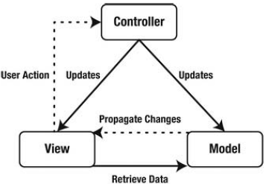
Architecture
The MVC pattern has 3 components, each having its own responsibilities:
The Model uses the View to render itself.
Based on a user action, the view triggers the controller, which in turn updates the model
The model then notifies the view to (re)render itself.

Slide 5
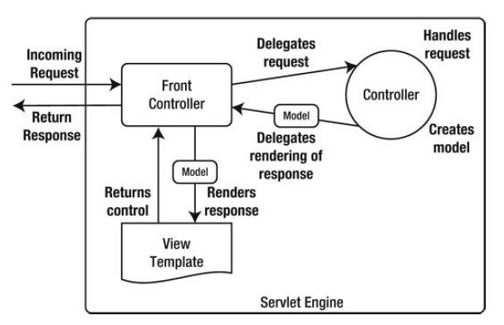
Architecture (cont.)
For the Web, the MVC pattern is implemented as a Model 2 architecture.
It incorporates a front controller that dispatches the incoming requests to other controllers.
In Spring MVC, this front controller is org.springframework.web.servlet.DispatcherServlet.

Slide 6
Spring MVC Features
Spring Web modules includes following web support features:
Clear separation of roles. Each role: controller, validator, command object. Form object, model object.
Customizable binding and validation.
Customizable handler mapping and view resolution. Handler mapping and view resolution strategies range from simple URL-based configuration.
Flexible model transfer. Model transfer with a name/value Map supports easy integration with any view technology.
Customizable locale, time zone and theme resolution.
Beans whose lifecycle is scoped to the current HTTP request or HTTP session.

Slide 7
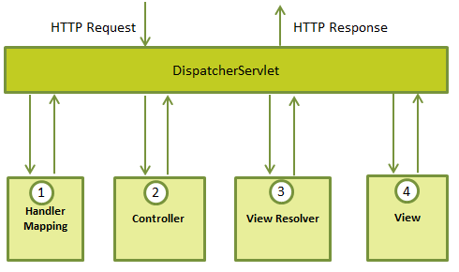
DispatcherServlet
The Spring Web MVC framework is designed around a DispatcherServlet that handles all the HTTP requests and responses.
After receiving an HTTP request, DispatcherServlet consuslts the HandlerMapping to call the appropiate Controller.
The Controller takes the request and calls the appropiate service based on GET/POST method.; the service method will set model data based on logic and return the view name to the DispatcherServlet.
The DispatcherServlet will take help from ViewResolver to pickup the defined view for the request.
The DispatcherServlet passes the model data to the view which is finally rendered to the browser

Slide 8
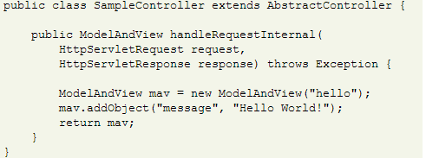
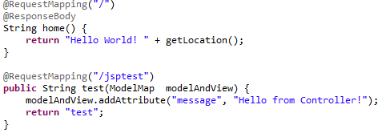
Controllers
Controllers execute the request, prepare the model and select a view to render.
The controller is the glue between the core application and the web interface.
In order to implement a controller either implement the org.springframework.web.servlet.mvc.Controller or annotate the class with org.springframework.stereotype.Controller.
Command Controllers: AbstractCommandController, AbstractFormController, SimpleFormController, AbstractWizardFormController, etc.
Other Controller implementations: UrlFilenameViewController, ParameterizableViewController, ServletForwardingController, ServletWrappingController, MultiActionController, SimpleFormController

Slide 9
Views
All MVC frameworks for web applications provide a way to address views.
Spring provides view resolvers which render in browser.
Spring also can work with JSP, Velocity templates and XSLT views.
There are 2 important interfaces:
ViewResolver: provides mapping between view names and actual views
View: address the preparation of the request and hands the request over the one of the view technologies

Slide 10
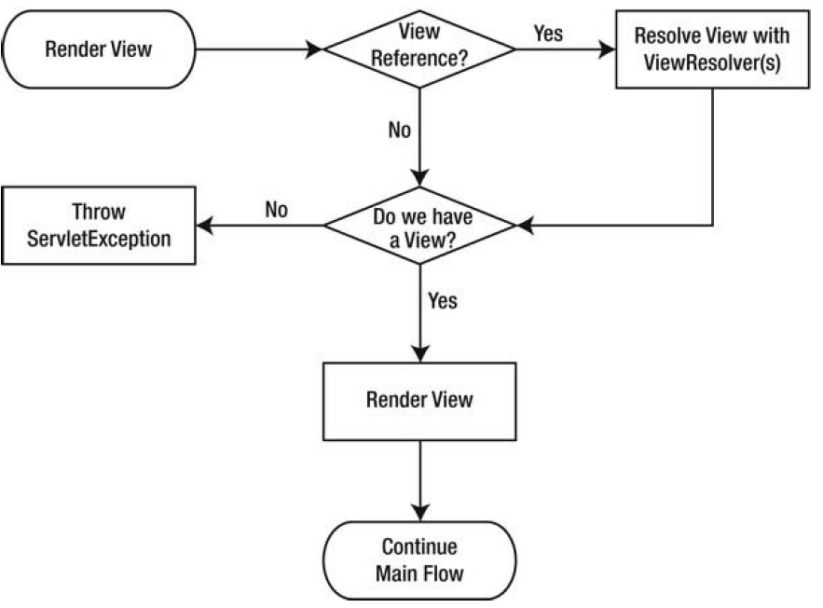
Views (cont.)
Resolving and rendering a view is part of the process.
The controller can return a View implementation or a reference to a view.

Slide 11
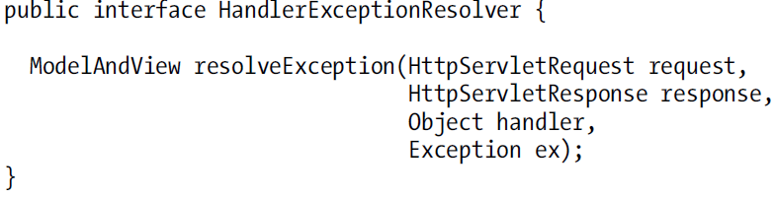
Exception handling
When an exception occurs during request processing, Spring will try to handle the exception.
Spring uses another strategy that can be utilized by implementing the org.springframework.web.servlet.HandlerExceptionResolver interface.
If the exception cannot be handled then the exception is rethrown so that the servlet container can handle it.

Slide 12
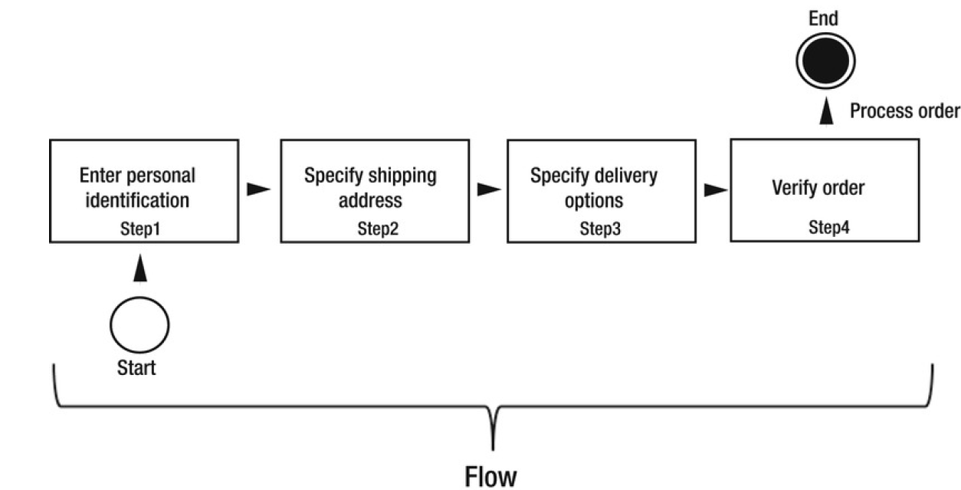
Spring Web Flow
Web Flow is all about creating these flows which is accomplish by managing state between the different flow steps.

Slide 13
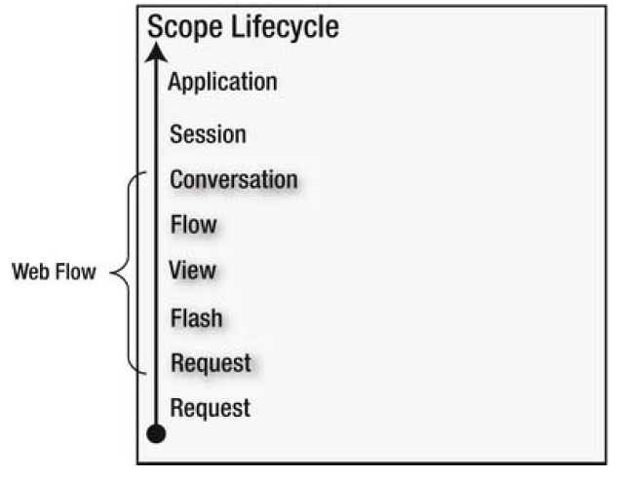
Spring Web Flow (cont.)
Web Flow offers a solution to this problem by introducing five new scopes: conversation, flow, view, flash and request.
The extra scopes are stored on the session scope.

Slide 14
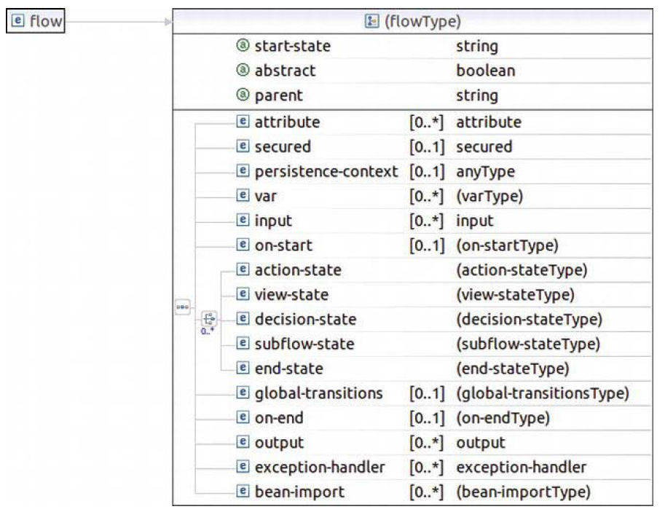
Spring Web Flow (cont.)
A flow is the main component in Spring Web Flow.
It’s an XML document interpreted by Web Flow.
A flow defines the possible steps in the application:
Which view should be rendered and the interaction between views
Which actions are possible and whether to delegate execution to application controllers

Slide 15
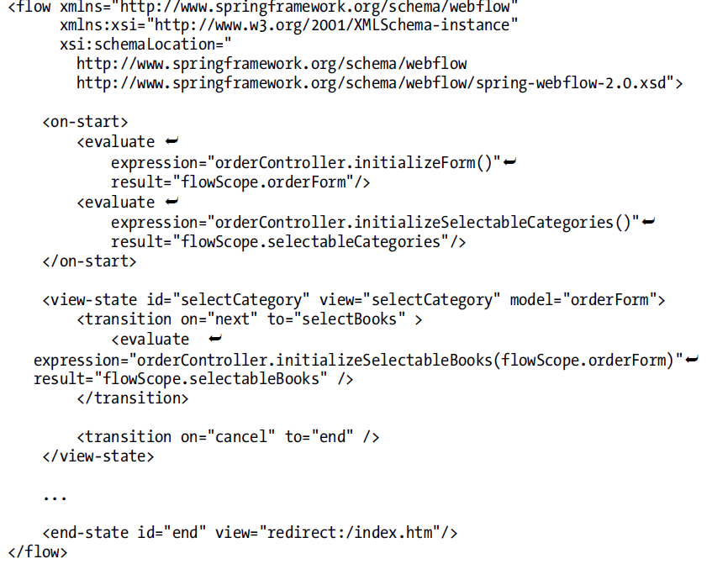
Spring Web Flow (cont.)
Spring Web Flow XML example shown bellow:

Slide 16
Conclussion
Spring is a powerful Java application framework used in a wide range of applications.
Spring MVC is very flexible.
Spring MVC can use a variety of view template technologies.
Spring Controllers are configured via IoC.

Slide 17

Bibliography
Apress Pro Spring MVC
http://www.slideshare.net/analizator/spring-framework-mvc
http://docs.spring.io/spring/docs/current/spring-framework-reference/html

Slide 18
Questions ?

